Slide 1

CPQ – Asia Bulk Design and Mockup Dec ‘19
Colt confidential

Slide 2

Document Release and Change Log Details
CPQ Asia
Version Number | 0.2
Date | 02 Dec , 2019
Change log | Bulk – Address Capture Bulk – Connectivity Check

Slide 3
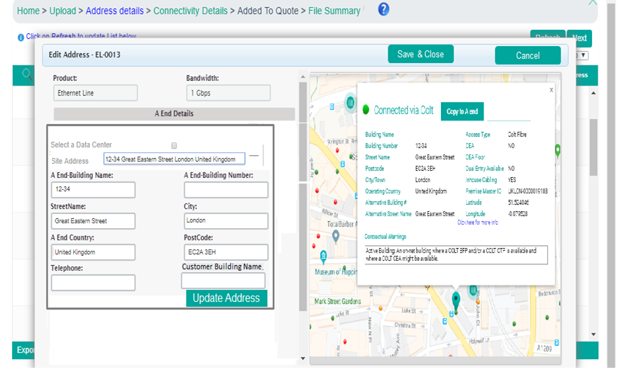
CPQ Asia : Input Asian site address: Bulk Upload Utility
There will be an additional field to allow user to optionally enter “ Customer Building Name” in Bulk upload utility.
Customer Building Name will be added on the UI but not to be used in the bulk templates

Slide 4
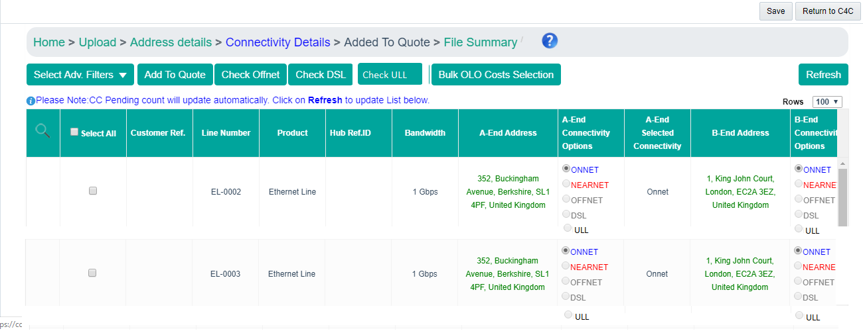
CPQ Asia: Connectivity Check: Bulk
ULL Check button should be introduced to execute the ULL check
No hiding rule is required for this button
For each line item a new radio button for ULL should be provided.
Remm Roppongi, Chome – 7, Minato City, Tokyo 106-0032
Villa Fontanne, Chome – 7, Minato City, Tokyo 106-0032

Slide 5
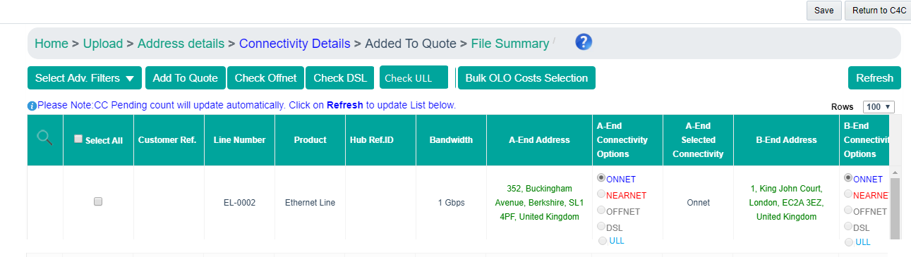
CPQ Asia: Connectivity Check: Bulk
In case the ULL check provides results back then the colour of the text (ULL) should change to blue. This indicates the availability
Remm Roppongi, Chome – 7, Minato City, Tokyo 106-0032
Villa Fontanne, Chome – 7, Minato City, Tokyo 106-0032

Slide 6
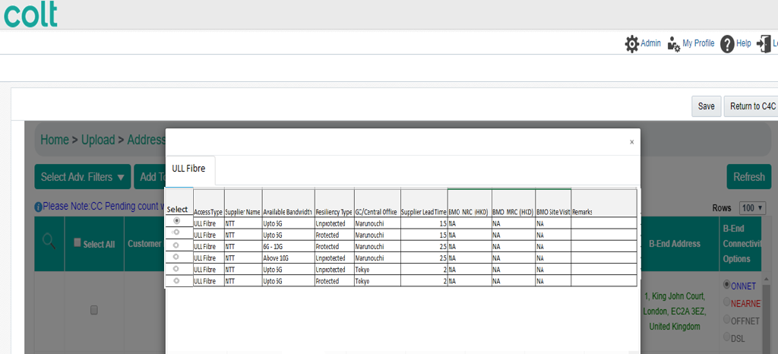
CPQ Asia: Connectivity Check: Bulk
Once user select the ULL Fibre posting running the ULL Fibre check then the records will be displayed to him in pop up (similar to Offnet)

Slide 7
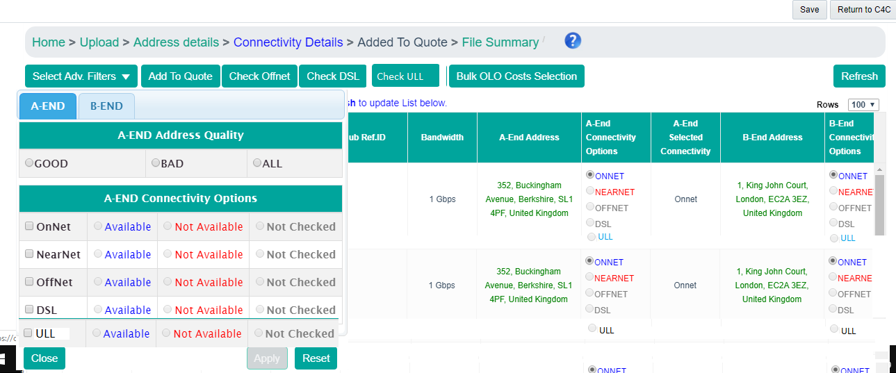
CPQ Asia: Connectivity Check: Bulk
Advance filter section to be updated to have the ULL option to filter out the records

Slide 8
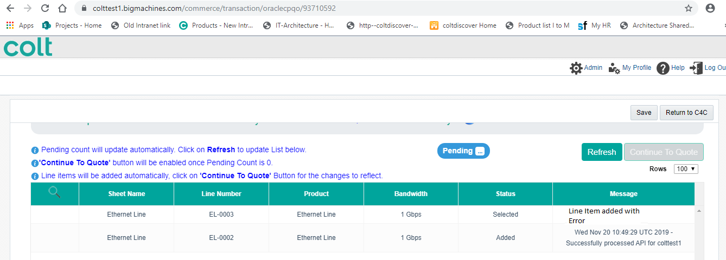
CPQ Asia: Connectivity Check: Bulk
In case the bandwidth and resiliency of the bulk record is not inline with the ULL fibre record selected on the connectivity page then system will show error to the user
User can correct the bandwidth on the CPQ config screen

